Slide 1
WIFI based indoor localization using decision tree algorithm
Mrinmoy Sarkar
Ph.D. student, ECE department
Instructor:
Dr. John Hyoshin Park
11/20/2018
Final Presentation

Slide 2
Outline
Problem statement
Existing solutions
Proposed method
Pros and cons of the method
Dataset
Visualization of the model
Results
Conclusion
References
CSE 804: Modeling and Visualization, Fall 2018

Slide 3
Problem Statement
How can we localize objects or things inside a building?
Why do we need such a system?
Asset tracking
Inventory management
Autonomous robot navigation
CSE 804: Modeling and Visualization, Fall 2018

Slide 4
Existing Solutions
Global Positioning System(GPS)
Does not work well indoor
Triangulation
Uses the geometric properties of triangles to estimate the target location
Instead of measuring the distance directly using received signal strengths (RSS), time of arrival (TOA) or time difference of arrival (TDOA) is usually measured
Suffers from multipath fading and shadowing
Proximity
Proximity algorithms provide symbolic relative location information
Relies upon a dense grid of antennas, each having a well-known position
Scene Analysis
Uses location fingerprint
Location fingerprinting refers to techniques that match the fingerprint of some characteristic of a signal that is location dependent
GPS
Triangulation
Proximity
Scene Analysis
CSE 804: Modeling and Visualization, Fall 2018

Slide 5
Proposed method
Decision tree based indoor localization using RSS signal from WIFI receiver. The technique lies in scene analysis.
There are two stages for this technique: offline stage and online stage (or run-time stage).
Stage 1:
During the offline stage, a site survey is performed in an environment. The location coordinates/labels and respective signal strengths from nearby base stations/measuring units are collected.
Stage 2:
During the online stage, a location positioning technique uses the currently observed signal strengths and previously collected information to figure out an estimated location.
Benefits of this method:
WIFI is readily available in any modern building
Don't need any new infrastructure
Cost effective
Don’t need any model of communication channel
The prediction model can be updated from time to time with new data
CSE 804: Modeling and Visualization, Fall 2018

Slide 6
Pros and Cons of DT
Pros:
easy to understand and interpret.
handles both numerical and categorical data.
does not require expert preprocessing of data.
known as a white box model.
works well with big data sets; takes a reasonable time to process a large amount of data.
mimics human decision making more closely than other approaches.
robust to noisy data .
Cons:
sometimes generates Overly-complex trees.
biased to the categorical variable, which has more levels.
searching of an optimal DT is known to be NP-complete.
CSE 804: Modeling and Visualization, Fall 2018

Slide 7
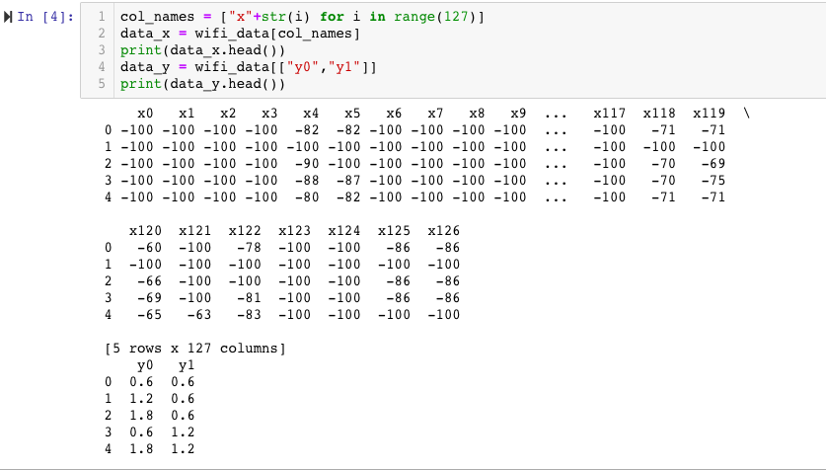
Dataset
650 samples of data with 127 features and 2D(x, y) location information associated with the 127 features. 127 features are RSSI level for each different WAPs retrieved during the campaign.
CSE 804: Modeling and Visualization, Fall 2018

Slide 8
Visualization of the model (Pruned Version)
CSE 804: Modeling and Visualization, Fall 2018

Slide 9
Results
Here, Score = (1-u/v), u = sum((y_true-y_pred)^2) and v = sum((y_true-mean(y_true))^2)
Maximum score can be 1.0.
CSE 804: Modeling and Visualization, Fall 2018

Slide 10
Conclusion
DT technique has been used for indoor localization. The average score of the trained model is 0.9.
Limitations:
The no. of training samples is limited (only 650).
Among 127 features, many of the features are assigned as -100dbm for many locations.
The dataset has only 2D location information.
Future directions:
Rather than DT, other ML techniques can be used to increase the score of the trained model.
More survey data can be collected to refine the training model.
The trained model can be used for real-time operation to validate its effectiveness.
CSE 804: Modeling and Visualization, Fall 2018

Slide 11
References
[1] Barsocchi, P., Crivello, A., La Rosa, D., & Palumbo, F. (2016, October). A multisource and multivariate dataset for indoor localization methods based on WLAN and geo-magnetic field fingerprinting. In Indoor Positioning and Indoor Navigation (IPIN), 2016 International Conference on (pp. 1-8). IEEE.
[2] Liu, H., Darabi, H., Banerjee, P., & Liu, J. (2007). Survey of wireless indoor positioning techniques and systems. IEEE Transactions on Systems, Man, and Cybernetics, Part C (Applications and Reviews), 37(6), 1067-1080.
CSE 804: Modeling and Visualization, Fall 2018

Slide 12
Thank you ?
CSE 804: Modeling and Visualization, Fall 2018

